Slide 1
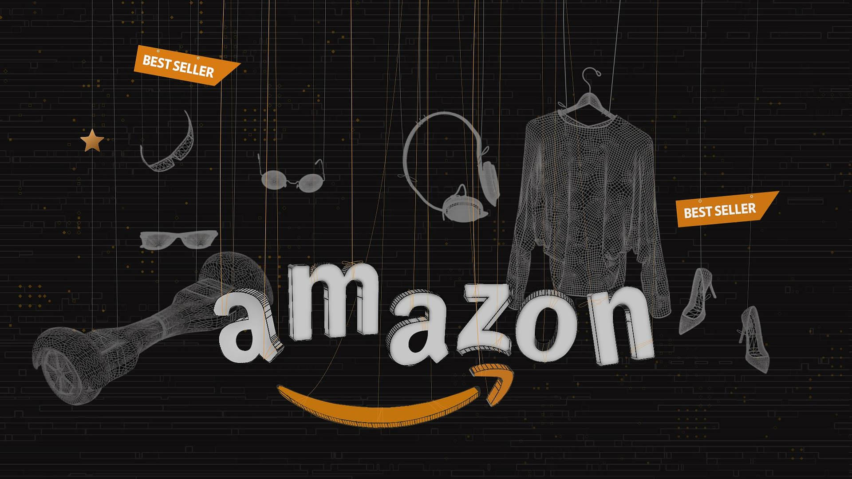
Analysis of Health Wearables using Amazon Reviews
Shivani Priyanka C

Slide 2
BACKGROUND:
The market for health wearables has been growing rapidly in recent years, with an increasing number of people using these devices to monitor their health and fitness. Health wearables refer to a range of devices that can track various aspects of a user's health and fitness, such as heart rate, steps taken, calories burned, and sleep patterns. These devices can be worn on the body, such as wristbands or smartwatches, or they can be integrated into clothing or accessories.
Amazon is one of the largest online retailers, and it offers a wide range of health wearables from various manufacturers. Customers can leave reviews on Amazon for the products they purchase, which provides valuable feedback for manufacturers and other customers. By analyzing these customer reviews, we can gain insights into the features that customers value the most, areas for improvement, and overall customer sentiment towards health wearables.
The analysis of health wearables using Amazon reviews can help manufacturers to improve their products and marketing strategies, and it can also help customers to make informed purchase decisions based on the experiences and feedback of other customers. Additionally, this analysis can help researchers and policymakers to gain insights into the trends and patterns in the market for health wearables and their impact on public health and wellness.

Slide 3

OBJECTIVES
The objective of analyzing health wearables using Amazon reviews is to gain insights into the overall sentiment of customers towards these devices, identify the key features that customers like or dislike, and understand areas of improvement for the health wearables. This analysis can help manufacturers to improve the design and functionality of their products, enhance customer satisfaction, and make informed decisions about marketing strategies. Additionally, the analysis can also help customers to make informed purchase decisions based on the experiences and feedback of other customers.

Slide 4

DATA COLLECTION
To collect the data for the analysis of health wearables using Amazon reviews, we can use web scraping techniques to extract the reviews from Amazon's website.
Web scraping, on the other hand, involves automatically extracting data from websites using web scraping tools such as BeautifulSoup or Scrapy. However, web scraping is subject to legal and ethical considerations, and it is important to ensure that the scraping process does not violate Amazon's terms of service or any laws or regulations.

Slide 5
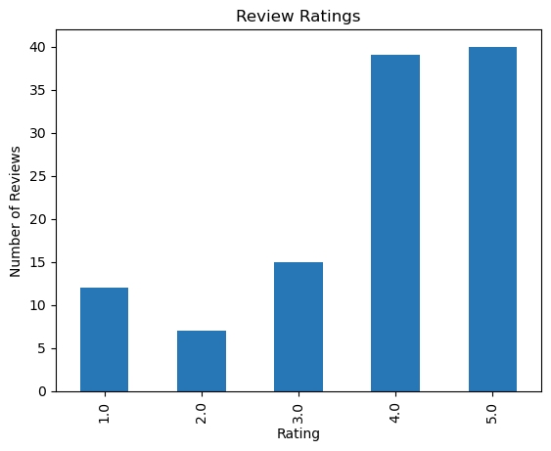
DATA VISUALIZATION
Bar chart of review ratings
This visualization provides insight into the distribution of review ratings in a dataset of product reviews. By displaying the counts of each rating in a bar chart, it is easy to see which ratings are most common. This information can be used to guide product development, marketing, and customer support efforts.

Slide 6
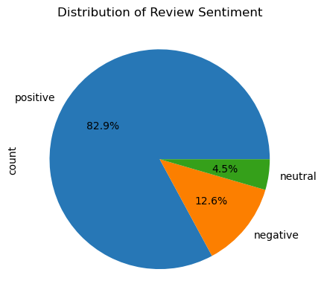
Pie chart of review sentiment
This visualization provides insight into the distribution of review sentiment in a dataset of product reviews. By displaying the percentage of each sentiment score in a pie chart, it is easy to see the relative frequency of each sentiment. This information can be used to guide decision-making and to help businesses better understand their customers' attitudes and opinions.

Slide 7
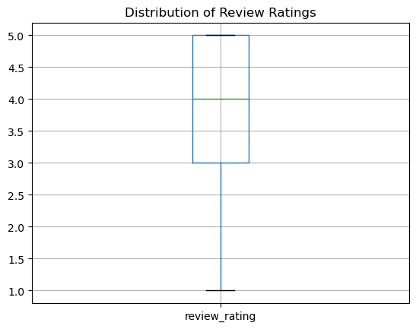
Box plot of review ratings
This visualization provides insight into the distribution of review ratings in a dataset of product reviews. By displaying the range, median, and quartiles of the review ratings in a box plot, it is easy to see the spread of the data and identify any outliers. This information can be used to guide decision-making and to help businesses better understand their customers' satisfaction levels.

Slide 8
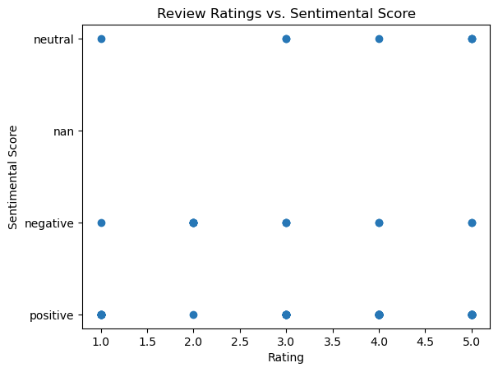
Scatter plot of review rating vs. sentimental score
This visualization provides insight into the relationship between the review rating and the sentimental score in a dataset of product reviews. By displaying the data in a scatter plot, it is possible to identify any patterns or trends in the data and to gain insights into the overall satisfaction of the customer base. This information can be used to guide decision-making and to help businesses better understand their customers' needs and preferences.

Slide 9
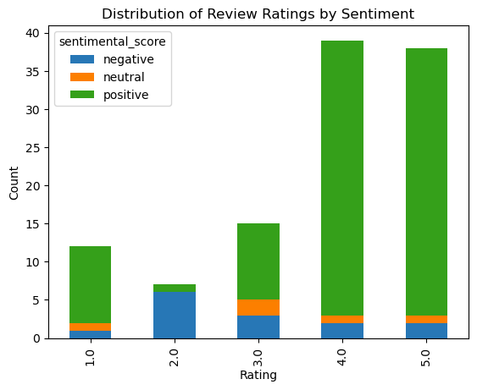
Stacked bar chart of review ratings and sentiment
This visualization provides insight into the distribution of review ratings by sentimental score in a dataset of product reviews. By displaying the data in a stacked bar chart, it is possible to see how many positive, negative, and neutral reviews there are for each rating, and to compare the distribution between different ratings. This information can be used to guide decision-making and to help businesses better understand the sentiment of their customer base.

Slide 10
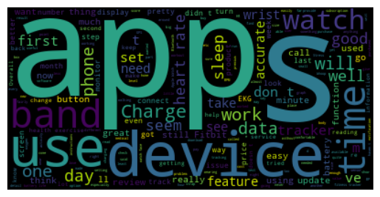
WORD CLOUD
This code generates a word cloud visualization of the text data in the 'review description' column of the given dataframe using the WordCloud library in Python.

Slide 11
DATA ANALYSIS
We have checked if we have null values in the dataframe and we have used the “describe” function to generate summary statistics for the "review_rating" column.
We have used the "value_counts" function to count the number of reviews for each sentimental score in the "sentimental_score" column. This function will provide a count of how many reviews received each sentimental score.
Split data into training and testing sets:
Preprocess text data:
Vectorize text data:
Train logistic regression model:
Evaluate model on test set:

Slide 12

CONCLUSION
In conclusion, the analysis of health wearables using Amazon reviews can provide valuable insights into customer sentiment, preferences, and areas for improvement. The growth of the market for health wearables and the increasing number of customers using these devices make it important for manufacturers to understand customer feedback and make informed decisions about product design and marketing strategies. Additionally, the analysis of health wearables using Amazon reviews can provide insights into the trends and patterns in the market for health wearables, which can be useful for researchers and policymakers interested in public health and wellness.

